Slide 1
AI/ML/DL/DS
CREATED BY: MAHIPAL SINGH

Slide 2
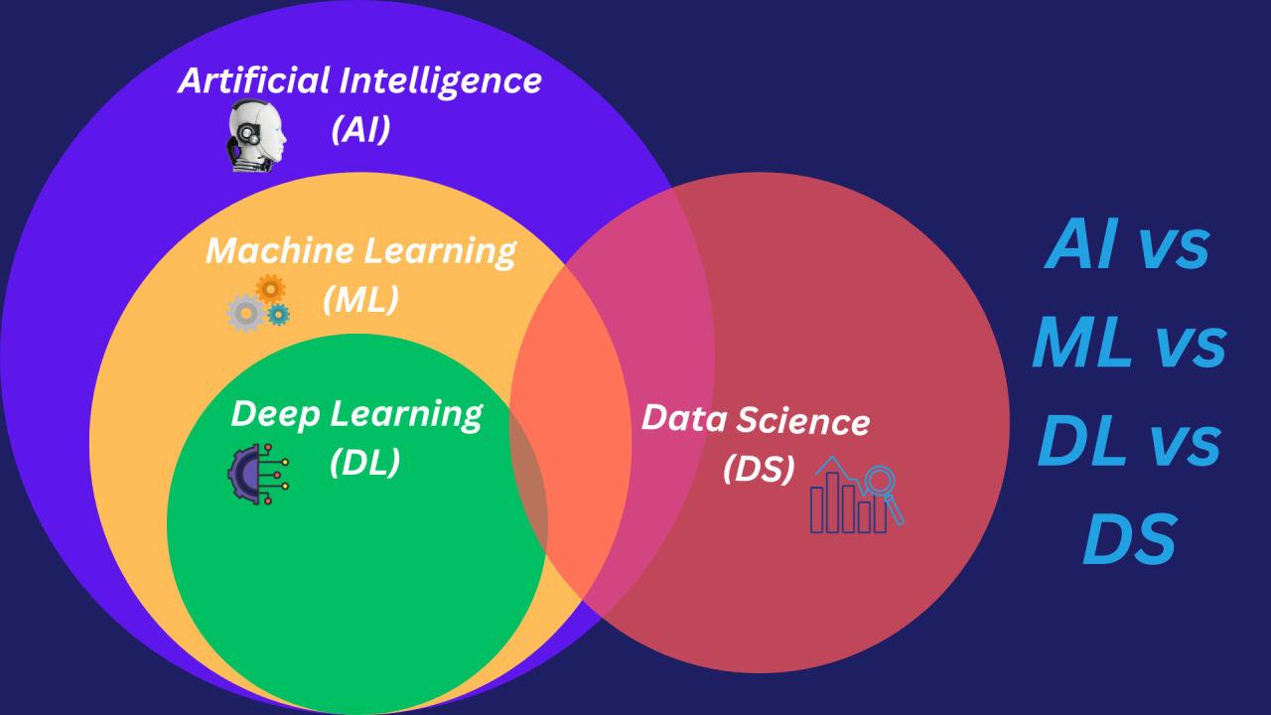

Slide 3
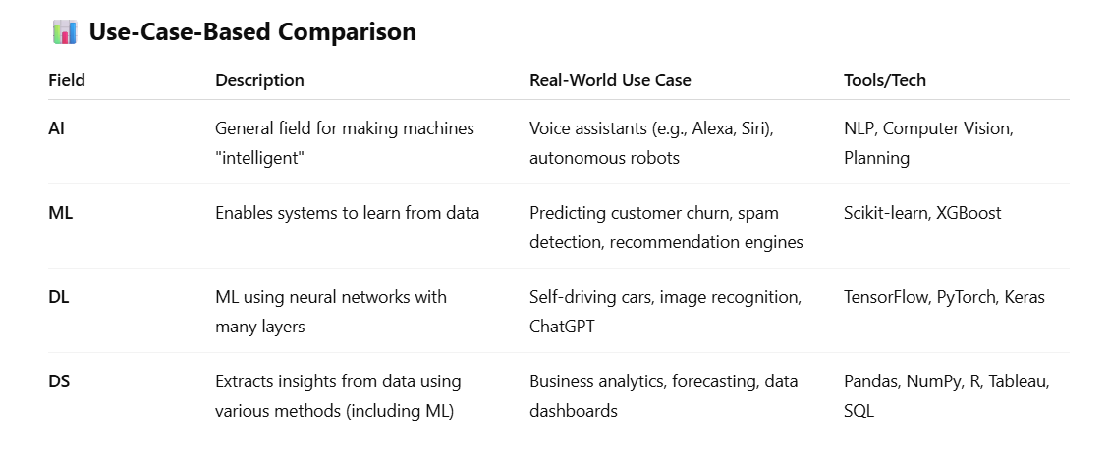

Slide 4
Example:
Scenario:: Self-driving Car
AI: The overall intelligence of the car (e.g., making driving decisions).
ML: Learning from past driving data to predict road behavior.
DL: Recognizing pedestrians and road signs from camera input.
DS: Analyzing driving data to optimize routes or fuel efficiency.

Slide 5
Healthcare Diagnosis
AI: Intelligent systems that assist doctors in making diagnoses.
ML: Predicting patient outcomes based on historical health records.
DL: Analyzing MRI scans or X-rays to detect tumors or fractures automatically.
DS: Exploring hospital data to optimize resource allocation and reduce patient wait times.

Slide 6
Streaming Platforms (e.g., Netflix, YouTube)
AI: Recommender engine that learns and adapts to your viewing habits.
ML: Predicting what you’ll want to watch next based on similar users and your history.
DL: Auto-generating subtitles using speech recognition; facial recognition in videos.
DS: Understanding content popularity, engagement, and churn analytics.

